Slide 1
Chapter 1 Objectives
The CCNA Topics Covered in this chapter include:
  Leased-line
  Circuit switch and
  Packet switched networks
  WAN terminology

Slide 2
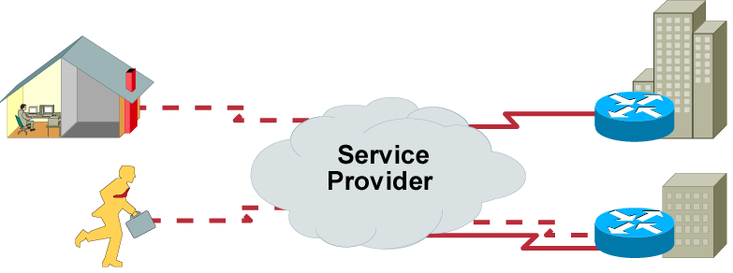
WAN Overview
WANs connect remote sites.
Connection requirements vary depending on user requirements, cost, and availability.

Slide 3
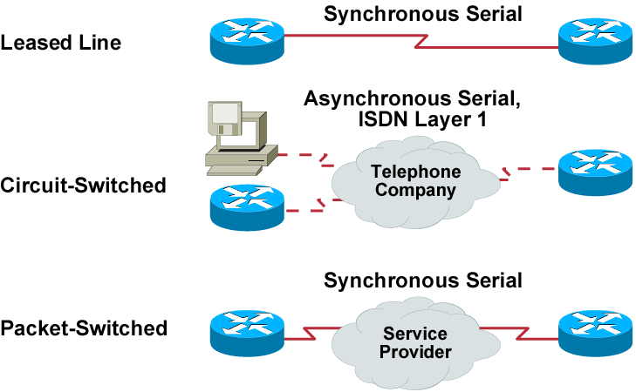
WAN Connection Types: Layer 1

Slide 4
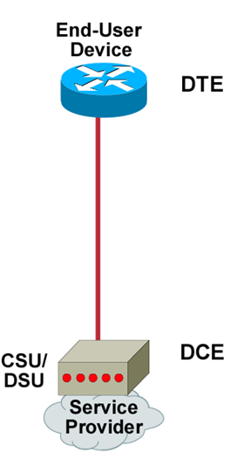
Serial Point-to-Point Connections

Slide 5
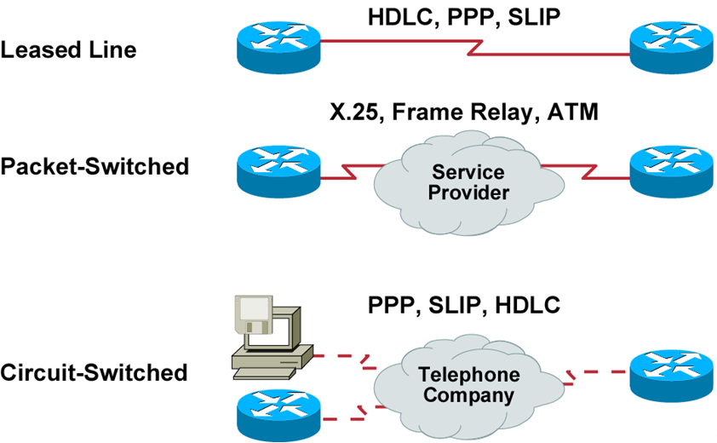
Typical WAN Encapsulation Protocols: Layer 2

Slide 6
Summary
  A WAN makes data connections across a broad geographic area so that information can be exchanged between distant sites.
  Some of the WAN connection types available are leased line, circuit-switched, and packet-switched.
  Cisco routers support the EIA/TIA-232, EIA/TIA-449, V.35, X.21, and EIA/TIA-530 standards for serial connections.
  To encapsulate data for crossing a WAN link, you can choose from a variety of Layer 2 protocols, including HDLC, PPP, SLIP, X.25/LAPB, Frame Relay, and ATM.

